Slide 1
Travel services
Web Programming - Final Project
Sneha Gavini
Naveen Kumar Vadlakonda

Slide 2
Problem Statement & user inputs
Problem: A combination website to book a Flight tickets, Parking and Car rentals.
Input: Login or Register, and then start booking for Flight tickets, car rentals and alos having parking from destination place.
Output: After payment, you will receive confirmation mail (extra feature).

Slide 3
Design
Please rewind back to our demo of our website.

Slide 4
Code/Languages
PHP
HTML
CSS
SQL
JavaScript
Ajax
Jquery
Bootstrap
Codeigniter Framework

Slide 5
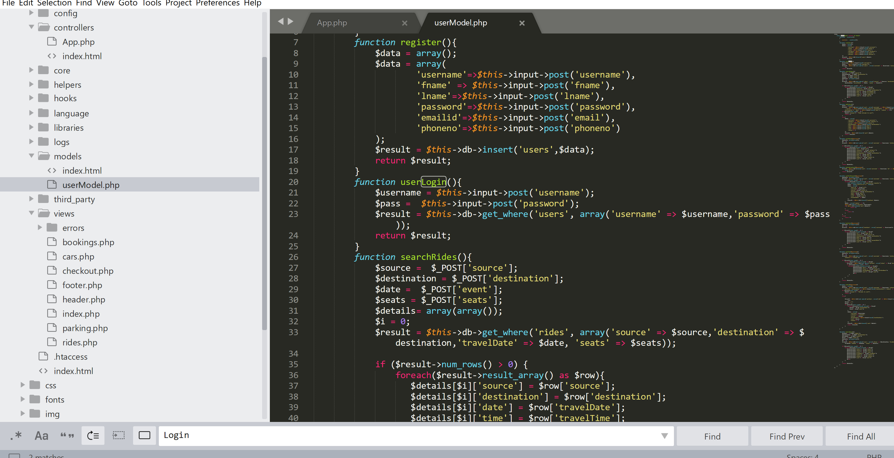
Code Snippets - Model (MVC)

Slide 6
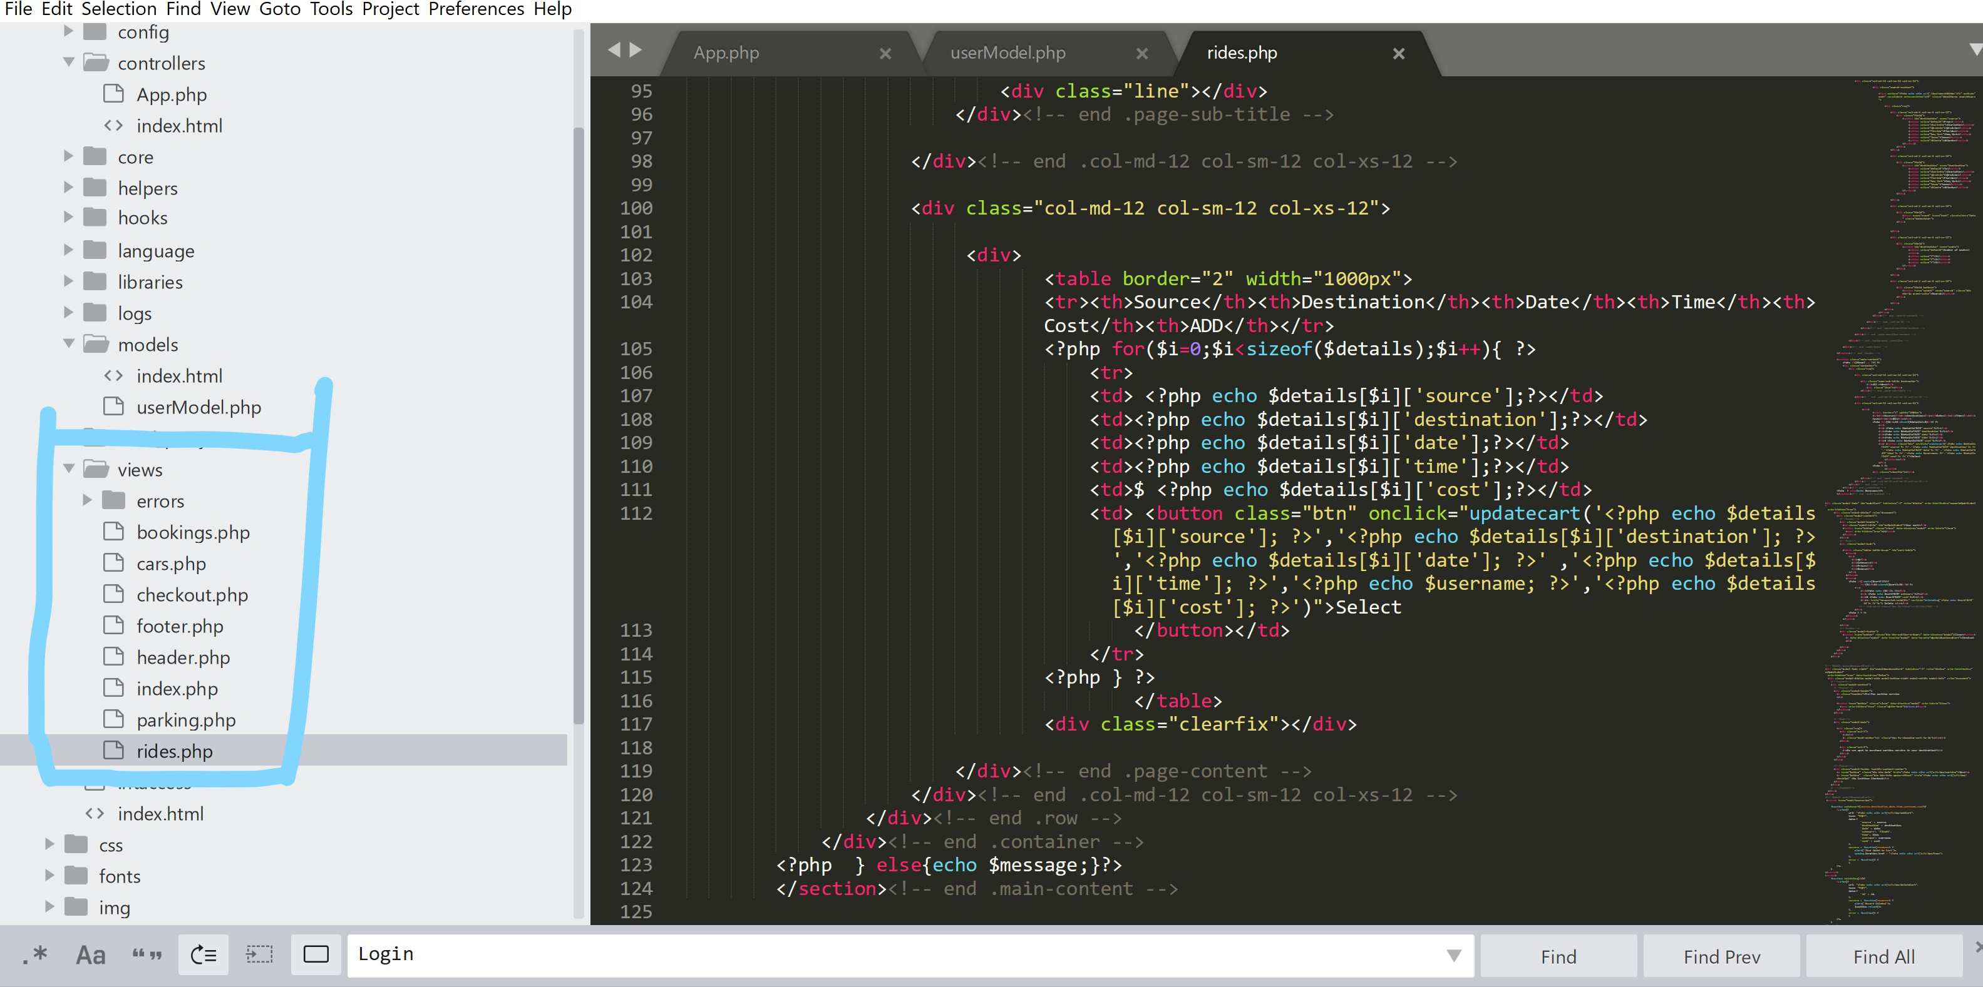
Code Snippets - Views (MVC)

Slide 7
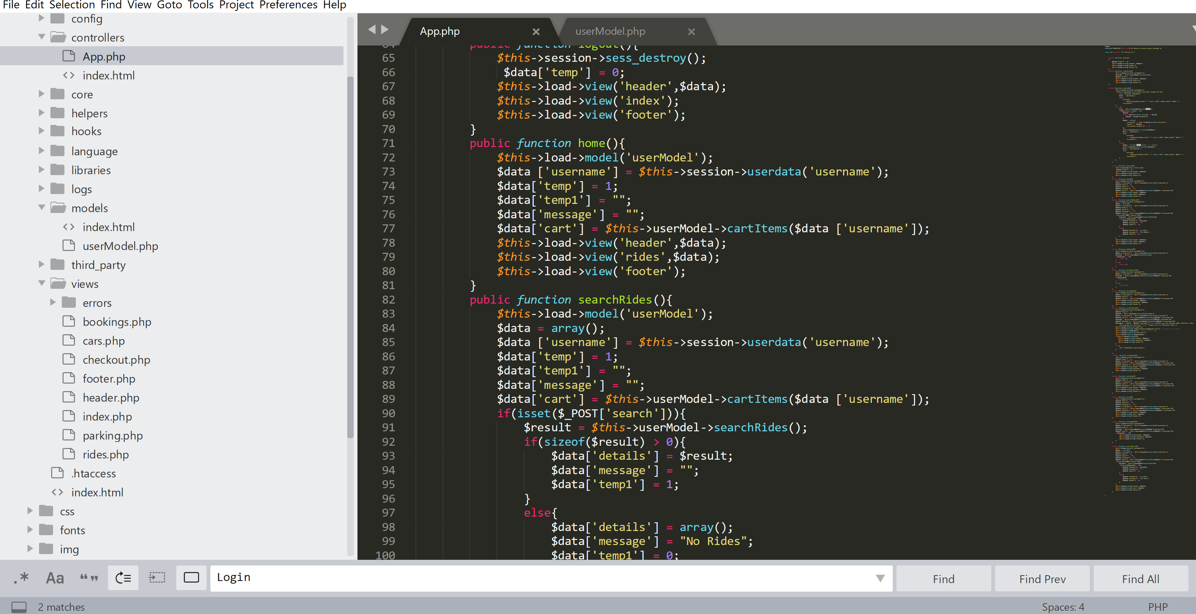
Code Snippets - Controller (MVC)

Slide 8
Testing
Testing was done manually.
Lots of refreshing and refining to adjust the looks of the pages.
Addition of mock data in our database and in our website to try out the different use cases, to see if everything is functionaly right.

